Slide 1
Group-work training
What is bad service and good service?
Your experience?
At your Branch Office?

Slide 2
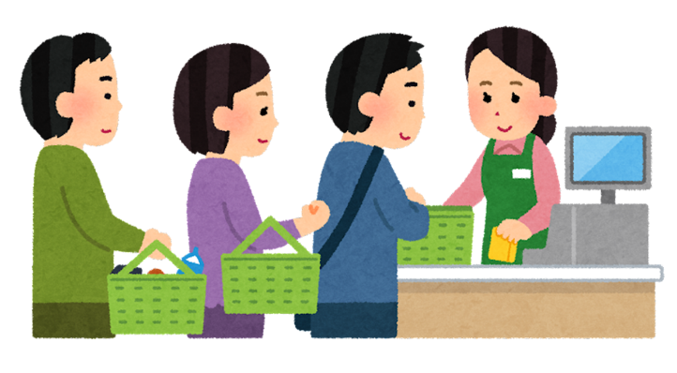
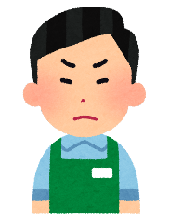
Are you angry for bad service at supermarket?
Having to wait.
Not finding what I want.
Not receiving the quality product or service that I expected or paid for.
Dealing with uninformed or inept employees
Being lied to.
Being treated as if I were the problem.
Being ignored.
Being addressed in inappropriate terms (Honey, Buddy, Dear, Little Lady).
How would you rewrite this scene at your Branch Office?
And what bad customer service at your Branch Office can you add to this list?
Being treated as if I were the problem.

Slide 3
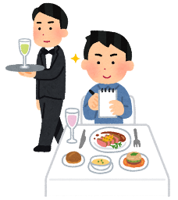
Some experiences associated with good service at restaurants?
Being treated courteously.
Being dealt with honestly.
Receiving a prompt response to requests.
Receiving fair treatment.
Receiving follow-up when a problem requires it.
How would you rewrite this scene at your Branch Office?
And what positive customer service at your Branch Office can you add to this list?

Slide 4
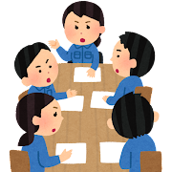
Group work
Individual session
Individual participants think and write down
Group session
Make small groups
At each group, select chair-person, presenter and minutes taker
Express each individual’s reply/answer
Discussion: Choose typical three event and discuss how to prevent such bad service.
Plenary session
Make a brief presentation
Comments

