Slide 1


The Project on Capacity Development of KUKL to Improve Overall Water Supply Service In Kathmandu Valley
Standard Operation Procedure
For
KTM-WIP Output-4 Activity
( 00- Basic Database Structure)
Drafted 2024/03/25 by Koji KIMURA (JET)
Revised 2024/

Slide 2
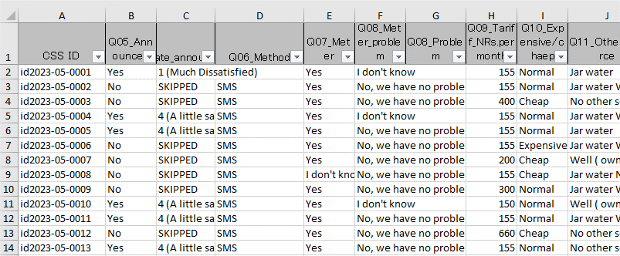
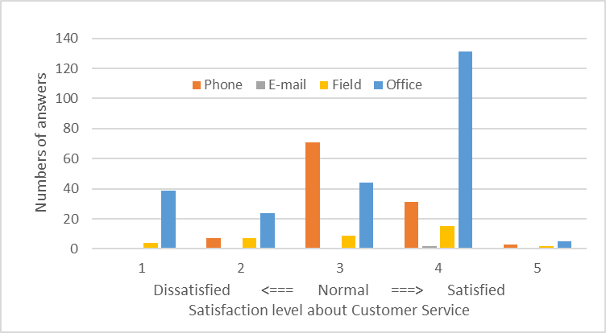
SOP for KTM-WIP Output-4 Activity ( 00- Information Processing )
I – Pre-condition
Digitisation of information (reception information and written information should be input into a PC).
NOTHING starts without this.
II – Input data to MS Excel
Why use MS Excel? Because its characteristics are;
Simple structure (consisting only of sheets)
Easy to use for beginners
Versatile (easy to share)
Visual (tables and graphs)
0 - 2

Slide 3


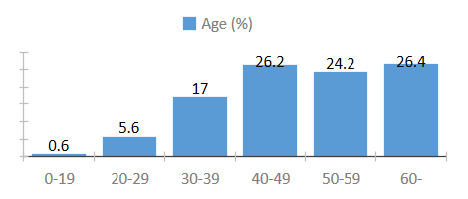
SOP for KTM-WIP Output-4 Activity ( 00- Information Processing )
III – Input data from MS Excel to Database
Use MS Access as the database.
Why use Database? Because its characteristics are;
Processing increasing data. (Difficult in Excel)
Less human error for large volumes of data. (Frequent in Excel)
Only simple commands needed.
With Simple Commands
Input
Summarized
0 - 3

Slide 4
SOP for KTM-WIP Output-4 Activity ( 00- Information Processing )
IV – Basic Database Structure
IV-1 Create Tables
Creating a table is easily done by <Copy & Paste> the original Excel table.
But two things you should be careful is to set an “ID” and a “Primary Key”.
“ID”, as the name indicates, identifies the record and is usually expressed as a symbol or number to prevent confusions and mistakes.
For example, in the case of information about a person, the name seems to be the best ID in our everyday lives.
On the other hand, it is also easy to make mistakes when filling in names in PCs.
0 - 4

Slide 5
SOP for KTM-WIP Output-4 Activity ( 00- Information Processing )
IV – Basic Database Structure
IV-2 “ID”
There are many different ways to register one person's name.
Ex.) Koji Kimura, Koji KIMURA, Kouji Kimura, KOJI KIMURA…
The “ID” should be perfectly identical, otherwise the database will not recognize them to be the same person. Conversely, others with the same name are regarded as the same person.
This condition must be fulfilled and an easy-to-understand “ID” must be named.
Ex.) id-2021-11-0001
Ex.) id-2021(survey year)-11(month)-0001(serial #)
So, “ID” is something like a name but more specified to avoid confusions and mistakes.
0 - 5

Slide 6
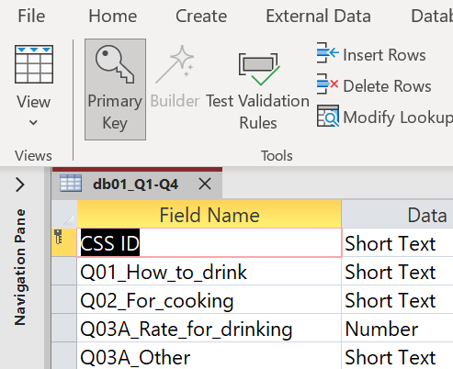
SOP for KTM-WIP Output-4 Activity ( 00- Information Processing )
IV – Basic Database Structure
IV-3 “Primary Key”
“Primary Key” is a setting on the database that allows records to be quickly aligned and sorted. To identify the records in a table and quickly locate the target data, “Primary Key” is set to a field that must be 'not duplicated with other records' and 'must be filled with data’(shouldn’t be blanks).
And usually, “ID” is set as the “Primary Key” on the database.
This is because it fulfils those conditions mentioned above.
0 - 6

Slide 7
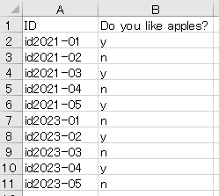
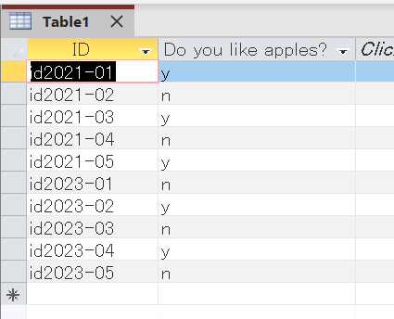
SOP for KTM-WIP Output-4 Activity ( 00- Information Processing )
IV – Basic Database Structure
IV-4 Relationship
Suppose five people were asked the question, "Do you like apples?" in 2021 and 2023. And the results are as follows.
Put this into the database.
0 - 7

Slide 8
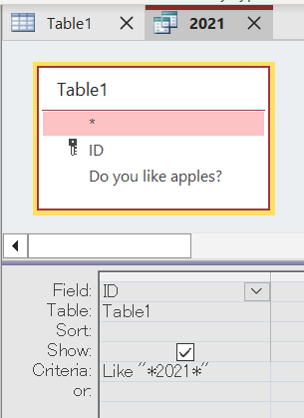
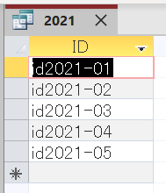
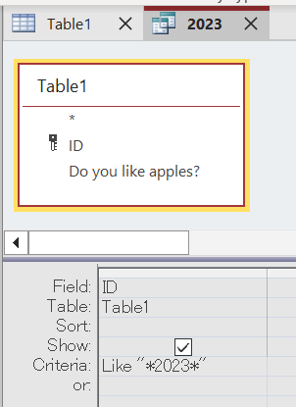
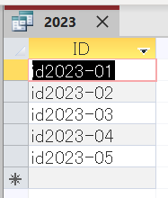
SOP for KTM-WIP Output-4 Activity ( 00- Information Processing )
IV – Basic Database Structure
IV-4 Relationship
Extract to organise the year.
0 - 8

Slide 9
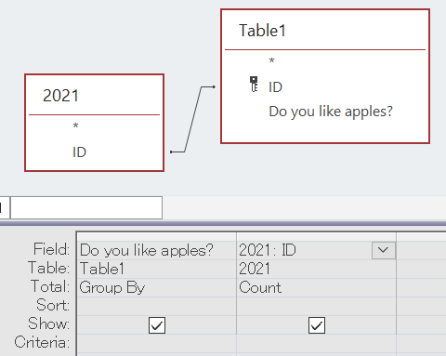

SOP for KTM-WIP Output-4 Activity ( 00- Information Processing )
IV – Basic Database Structure
IV-4 Relationship
Add the main table and "2021" to the query and link them by ID.
May be linked automatically.
The results of the query run are as follows
0 - 9

Slide 10
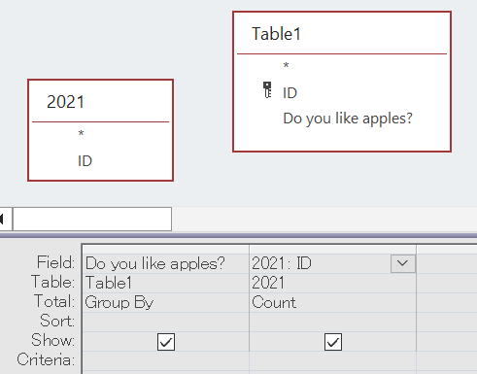

SOP for KTM-WIP Output-4 Activity ( 00- Information Processing )
IV – Basic Database Structure
IV-4 Relationship
What happens when the link is broken?
The results of the query run are as follows.
With the ID no longer linking, the database is forced to seek all kinds of combinations, and the candidate figures become larger.
If this is done for tables with large amounts of information, the database will seek infinite combinations of data,
The PC freezes, so BE SURE TO LINK them all the time.
0 - 10

Slide 11
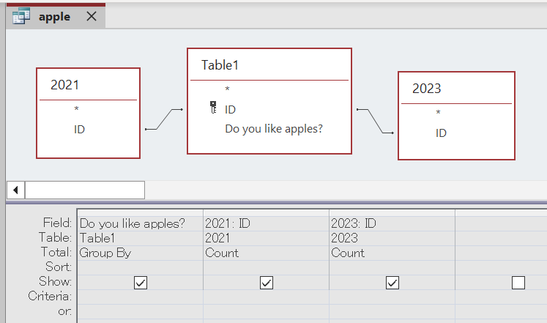
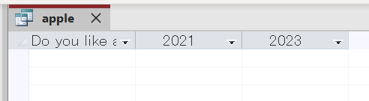
SOP for KTM-WIP Output-4 Activity ( 00- Information Processing )
IV – Basic Database Structure
IV-4 Relationship
When forming multiple relationships, there are some points to note.
The results of the query run are as follows.
This means that there are no records matching both "2021" and "2023"..
0 - 11

Slide 12
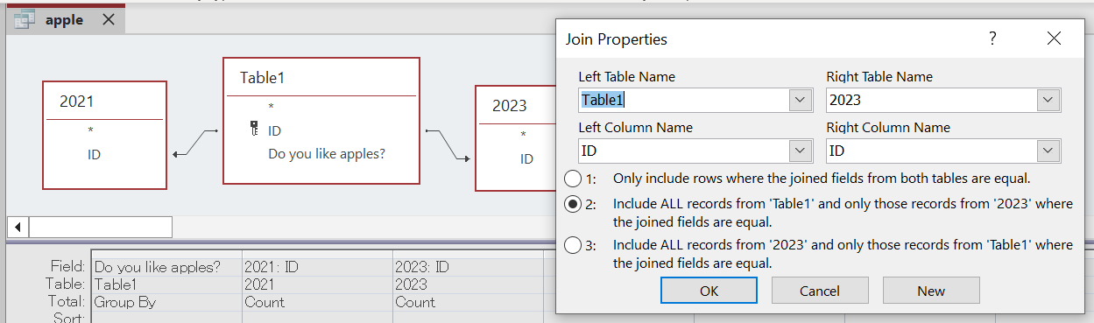
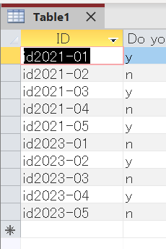
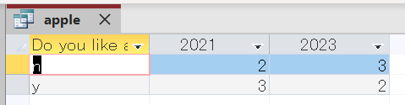
SOP for KTM-WIP Output-4 Activity ( 00- Information Processing )
IV – Basic Database Structure
IV-4 Relationship
In such cases, use "Join Properties" to define the direction of the reference.
This is done correctly by referencing from the table containing the ID.
0 - 12

