Slide 1


The Project on Capacity Development of KUKL to Improve Overall Water Supply Service In Kathmandu Valley
Standard Operation Procedure
For
KTM-WIP Output-4 Activity
( 01- Data Process of CSS)
Drafted 2022/12/02 by Koji KIMURA (JET)
Revised 2022/12/07 by Gita Pokharel
Revised 2023/07/21 by Kabin Dhoj Adhikari
Revised 2025/02/11 by Koji Kimura

Slide 2
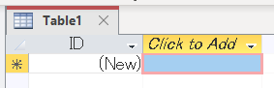
SOP for KTM-WIP Output-4 Activity ( 01- Data Process )
I – Creating a Database
I – 01. Organize MS Excel sheets to be used in MS Access (database application).
You will find many mistakes from carelessly prepared files.
e.g. misspelling, different words for same meanings (forty, Forty, 40,..).
So, use “replace” function ([Ctrl]+[H]) to unify and simplify data.
I – 02. Input data from Excel to Access (by Copy & Paste).
Excel <Select & Copy> data
Access <Create> - <Table>
- <Paste> in a blue (selected) cell.
I - 2

Slide 3
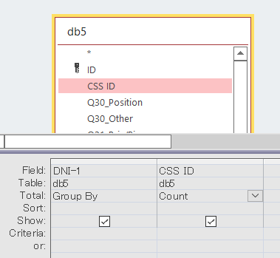
SOP for KTM-WIP Output-4 Activity ( 01- Data Process )
I – Creating a Database
<Close the tab> - <Save> - Name the tables in Access as you will find easily later.
II – Number of Groups
<Create Query Dsgn.> - <Add Tables> you need - <D-click (or drag & drop)> fields you need so that they appear in the table below.
(@ anywhere in the table) <Right click> - <Select “Totals”>
(@ the field you want to categorize) <Select “Group by”>
(@ the field you want to count) <Select “Count”>

Slide 4
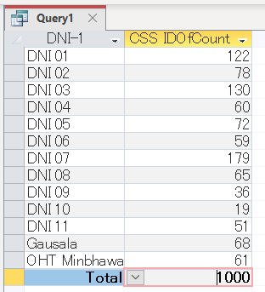
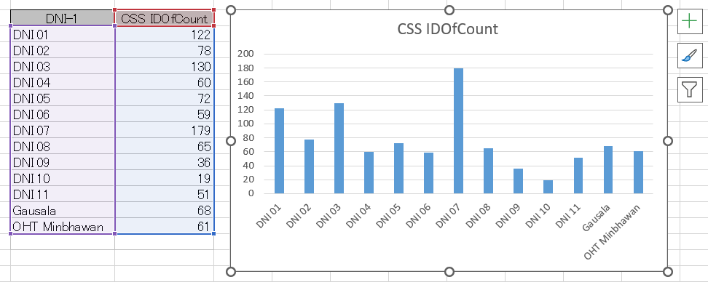
SOP for KTM-WIP Output-4 Activity ( 01- Data Process )
II – Number of Groups
(@ the upper left button) <Click “View”> to check.
<C&P> the table to Excel.
<Insert> - <Column Chart>

Slide 5
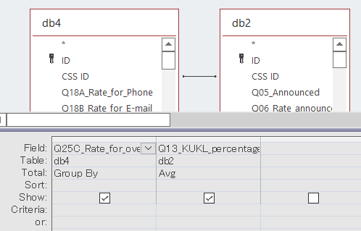
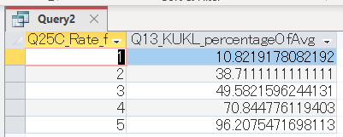
SOP for KTM-WIP Output-4 Activity ( 01- Data Process )
III – Relation between 2 Parameters
III-01. Simple Comparison
<Create Query Dsgn.> - <Add Tables> you need - <Connect> data ID.
<D-click (or drag & drop)> fields you need so that they appear in the table below.
(@ anywhere in the table) <Right click> - <Select “Totals”>
(@ the field you want to categorize) <Select “Group by”>
(@ the field you want to calculate the average) <Select “Avg”>

Slide 6
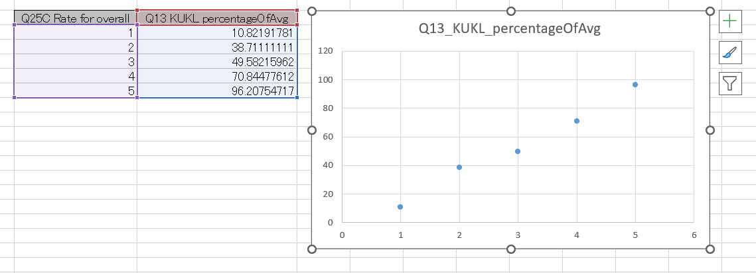
SOP for KTM-WIP Output-4 Activity ( 01- Data Process )
III – Relation between 2 Parameters
III-01. Simple Comparison
<C&P> the table to Excel.
<Insert> - <Scatter Chart>

Slide 7
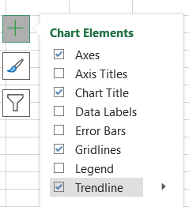
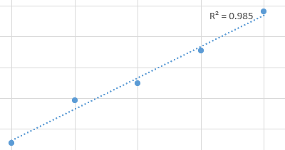
SOP for KTM-WIP Output-4 Activity ( 01- Data Process )
III – Relation between 2 Parameters
III-01. Simple Comparison
(@ “+”) <Check “Trendline”> - <More Option> - <Check “Display R”>
<Calculate> by “=sqrt(xxx)” so that you can tell the linearity.
=SQRT(0.985) gives “0.992”.
It is said more than 0.5 correlation coefficient indicates positive proportional relationship between 2 factors. And if correlation coefficient is 1, the proportionality is perfect.
Here, 0.992 correlation coefficient, aka R, means the proportionality is nearly perfect and the causal relationship is obvious.

Slide 8
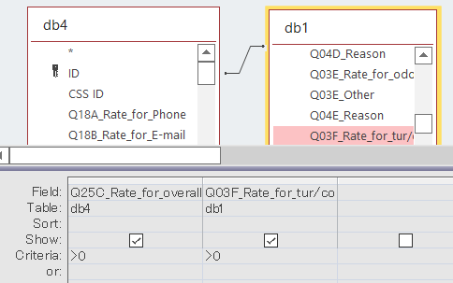
SOP for KTM-WIP Output-4 Activity ( 01- Data Process )
III – Relation between 2 Parameters
III-02. Comparison with Care
<Create Query Dsgn.> - <Add Tables> you need - <Connect> data ID.
<D-click (or drag & drop)> fields you need so that they appear in the table below.
(@ “Criteria”) <Write “>0”> so that you only have valid data.

Slide 9
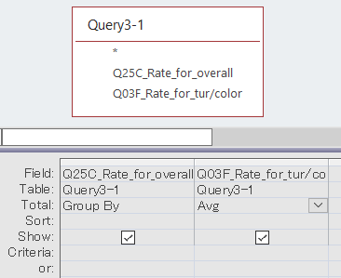
SOP for KTM-WIP Output-4 Activity ( 01- Data Process )
III-02. Comparison with Care
<Create Query Dsgn.> - <Add Queries> you prepared.
<D-click (or drag & drop)> the 2 fields.
(@ anywhere in the table) <Right click> - <Select “Totals”>
(@ the field you want to categorize) <Select “Group by”>
(@ the field you want to count) <Select “Avg”>
overall | >0 | With 0
1 | 2.246753247 | 0.789954338
2 | 2.633333333 | 2.194444444
3 | 2.81865285 | 2.55399061
4 | 3.665653495 | 3.6
5 | 4.867924528 | 4.867924528
In this case, 0 “no answer” shouldn’t be included because the valid answers are 1 to 5 (dislike to like).
Before calculation, note that what kind of data you are dealing with.

Slide 10
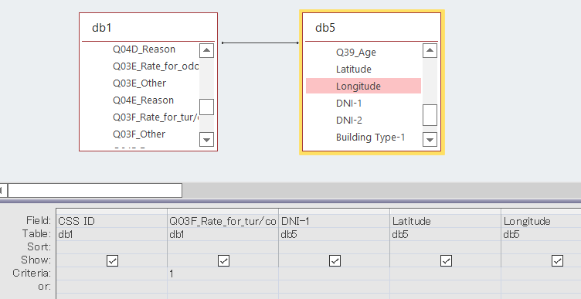
SOP for KTM-WIP Output-4 Activity ( 01- Data Process )
IV – Plotting Data on Map
IV-01. Preparing Plotting Data
<Create Query Dsgn.> - <Add Tables> you need - <Connect> data ID.
<D-click (or drag & drop)> fields you need so that they appear in the table below. Add 5 fields to fit in a HP for conversion (CSV to KML).
(@ “Criteria”) <Write “1”> so that you can categorize the plot data.

Slide 11

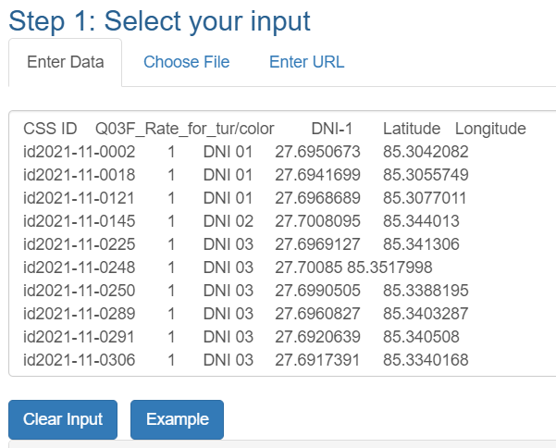
SOP for KTM-WIP Output-4 Activity ( 01- Data Process )
IV-02. Converting Plotting Data
(@ Internet browser) <Search “csv to kml”> - find a conversion service such as “www.convertcsv.com/csv-to-kml.htm”.
<C&P> the table (Access) to the HP.

Slide 12
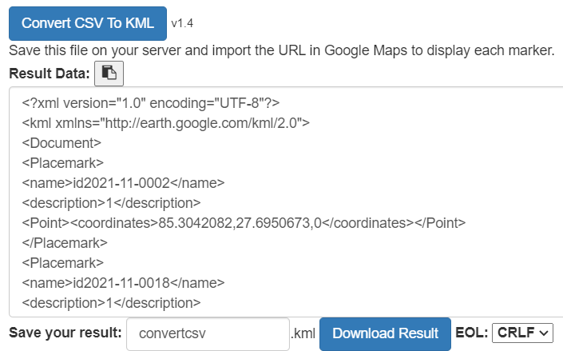
SOP for KTM-WIP Output-4 Activity ( 01- Data Process )
IV-02. Converting Plotting Data
<Convert CSV to KML> - <Download Result>.

Slide 13
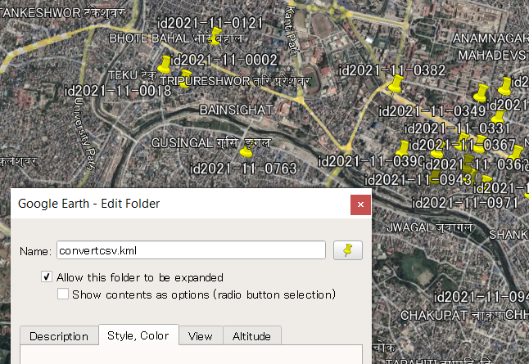
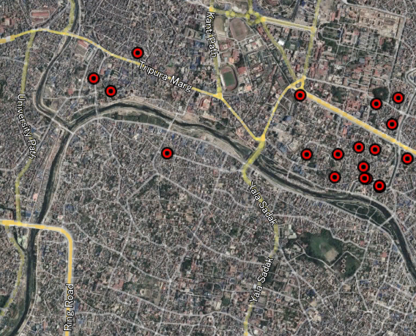
SOP for KTM-WIP Output-4 Activity ( 01- Data Process )
IV-03. Plotting Data on Map
<Drag & Drop> the KML file to “Google Earth”.
<Change “Property”> to make plots look better.

Slide 14
SOP for KTM-WIP Output-4 Activity ( 01- Data Process )
IV-03. Plotting Data on Map
<Repeat from “IV-01.”> so that you can obtain a Map with plots.

Slide 15
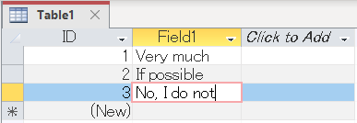
SOP for KTM-WIP Output-4 Activity ( 01- Data Process )
V – Multiple Bar Chart
V-01. Preparing Individual Data Table
<Create Query Dsgn.> - <Add Tables> you need - <D-click (or drag & drop)> fields you need so that they appear in the table below.
(@ anywhere in the table) <Right click> - <Select “Totals”>
(@ the field you want to categorize) <Select “Group by”>
(@ the field you want to count) <Select “Count”>
V-02. Preparing Reference Table
<Create Table> - (@ Field 1) <Input> data in order you want - <Save>.

Slide 16
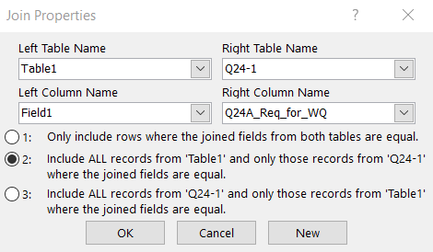
SOP for KTM-WIP Output-4 Activity ( 01- Data Process )
V – Multiple Bar Chart
V-03. Connecting All Tables
<Create Query Dsgn.> - <Add Tables> you prepared - <Add Queries> you need.
<Connect> fields with the same data from the table to other queries.
(@ Connected line) <Right Click> - (@ Join Property) select “2” so the Queries will be referred by the Reference Table.

Slide 17
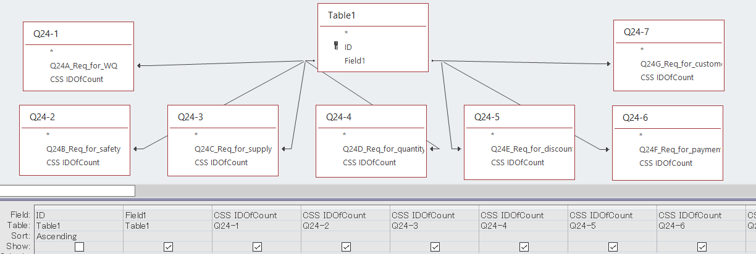
SOP for KTM-WIP Output-4 Activity ( 01- Data Process )
V – Multiple Bar Chart
V-03. Connecting All Tables
<D-click (or drag & drop)> fields you need so that they appear in the table below.
(@ “Sort” of “ID”) <Select “Ascending”> so that data appear in order. If ID is not needed to be shown, uncheck “Show”-box.

Slide 18
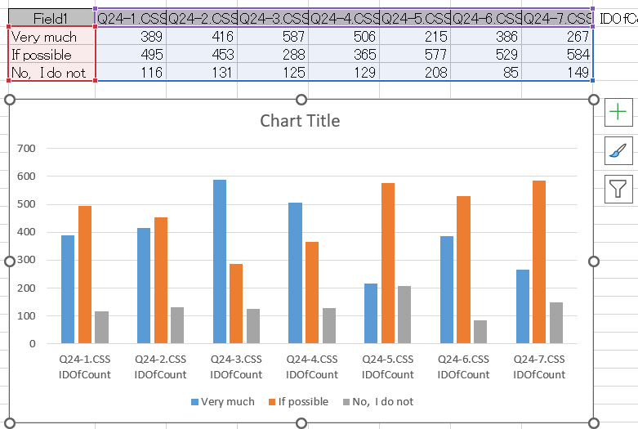
SOP for KTM-WIP Output-4 Activity ( 01- Data Process )
V – Multiple Bar Chart
V-04. Multiple Bar Chart
<C&P> the table to Excel
<Insert> - <Column Chart>

Slide 19
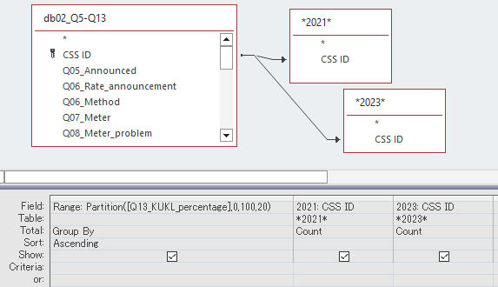
SOP for KTM-WIP Output-4 Activity ( 01- Data Process )
VI – Histogram (Partition)
To create a histogram chart, use a function such as;
“Partition(number, start, stop, interval)”
e.g.,
Partition([Q13_KUKL_percentage], 0, 100, 20)

Slide 20
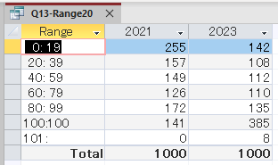
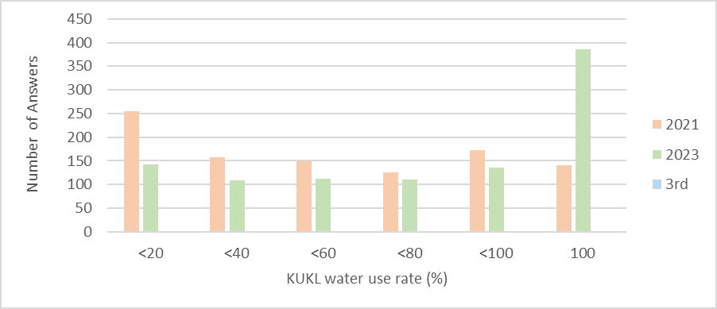
SOP for KTM-WIP Output-4 Activity ( 01- Data Process )
VI – Histogram (Partition)
By the query prepared as shown in the previous page, this table is given.
Then, with Excel, a histogram chart like below can be created.

Slide 21
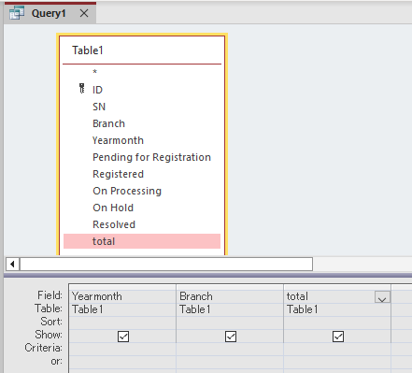
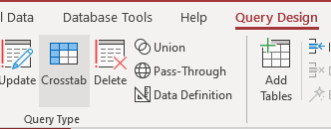
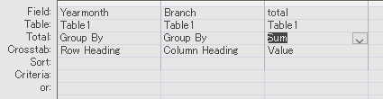
SOP for KTM-WIP Output-4 Activity ( 01- Data Process )
VII – Crosstab
When you create a new query, select 3 fields that you want to use as “row heading (title)”, “column heading” and “value”.
Then, select <Query Design> - <Crosstab>.
@”Crosstab”, select <Row Heading>, <Column Heading>, and <Value>.
Do not forget selecting <Sum> for the “Value” field.

Slide 22
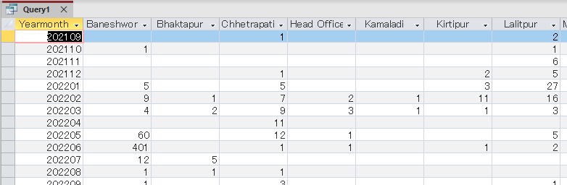
SOP for KTM-WIP Output-4 Activity ( 01- Data Process )
VII – Crosstab
By this “Crosstab” query, a table is created
with the first column as <Row Heading>,
with the column title as <Column Heading>, and
with the contents as <Value> in the table.

Slide 23
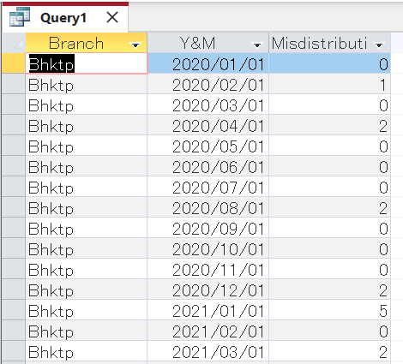
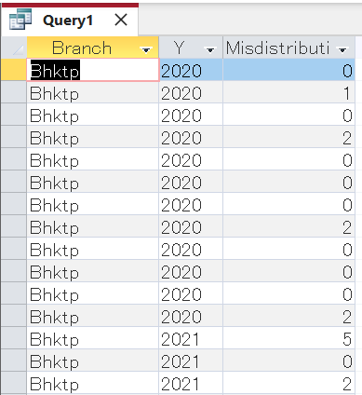
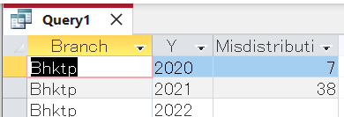
SOP for KTM-WIP Output-4 Activity ( 01- Data Process )
VIII – Format
The command “Format” gives you selected format from longer texts. For example, << Format([Y&M],"yyyy") >> will give you only YEAR from “yyyy/mm/dd”.
And if you “Group By” the records, you will obtain summarized data.

Slide 24
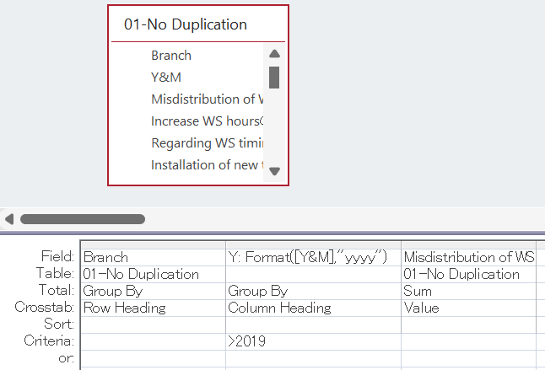
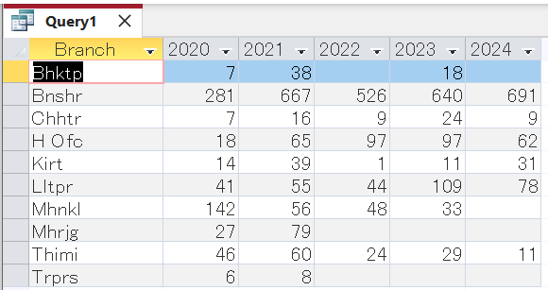
SOP for KTM-WIP Output-4 Activity ( 01- Data Process )
VIII – Format
In addition, the Querry can be “Crosstab” so it can be a simple summary table with just one Querry.

