Slide 1
The Project on Capacity Development of KUKL to Improve Overall Water Supply Service In Kathmandu Valley
Standard Operation Procedure
For
KTM-WIP Output-4 Activity
( 02- Data Process of Grievance Records)
Drafted 2022/12/12 by Koji KIMURA (JET)
Revised 2023/xx/xx by
Revised 2023/xx/xx by

Slide 2
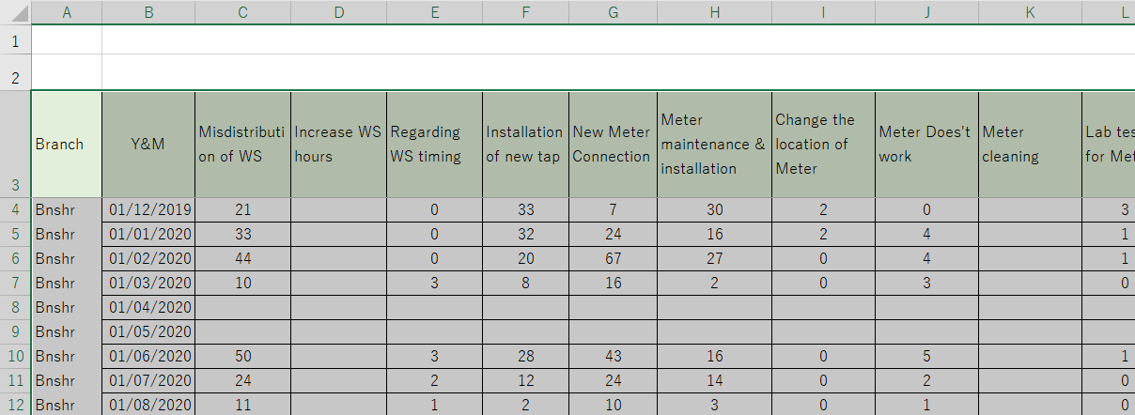
SOP for KTM-WIP Output-4 Activity ( 02- Data Process of Grievance Records )
I – Creating a Database
I – 01. Organize MS Excel sheets to be used in MS Access (database application).
I – 02. Input data from Excel to Access.
Excel <Select & Copy> data inside of the original table.

Slide 3
SOP for KTM-WIP Output-4 Activity ( 02- Data Process of Grievance Records )
I – 02. Input data from Excel to Access.
Access <Create> - <Table>
- <Paste> in a blue (selected) cell.
<< NOTE >>
Error may occur when the following symbols are used for table titles.
Dot (.), exclamation mark (!), brackets ([]), (()), ({}),
extra space( ) before or after the words, and others such as;
(?), (@), ("), (‘), (#), (%), (~), (;), (|), etc.
<Close the tab> - <Save> - Name the tables in Access as you will find easily later.

Slide 4
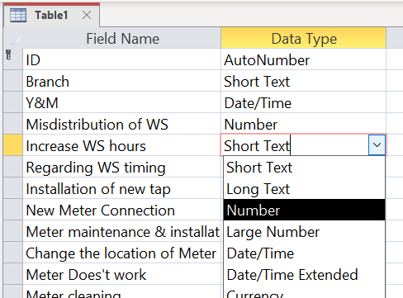
SOP for KTM-WIP Output-4 Activity ( 02- Data Process of Grievance Records )
I – 02. Input data from Excel to Access.
(@ Design View) – change “Data Type” from “Short Text” to “Number”.
<< NOTE >> if the first data is blank, it is recognized as “Short Text”. This will cause trouble when you input numbers later.

Slide 5
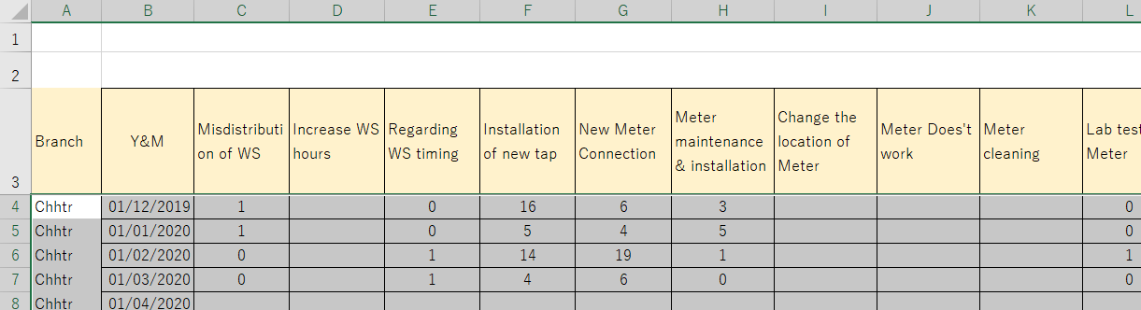
SOP for KTM-WIP Output-4 Activity ( 02- Data Process of Grievance Records )
I – 02. Input data from Excel to Access.
Back to Excel, <Select & Copy> only data (without the titles).
Back to Access, <Select> valid cells - <Paste>.
Repeat <Copy & Paste> to complete the Access table.
<< NOTE >> Do not select the first cell which is automatically numbered by PC.

Slide 6
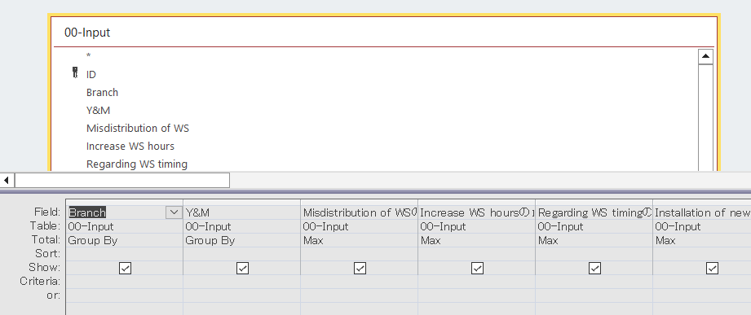
SOP for KTM-WIP Output-4 Activity ( 02- Data Process of Grievance Records )
II – Preparation of “Unified” Query
<Create Query Dsgn.> - <Add Tables> of input data - <D-click (or drag & drop)> all fields except “ID” so that they appear in the table below.
(@ anywhere in the table) <Right click> - <Select “Totals”>
(@ the field you want to categorize) <Select “Group by”>
(@ the field you want to use) <Select “Max”>

Slide 7
SOP for KTM-WIP Output-4 Activity ( 02- Data Process of Grievance Records )
II – Preparation of “Unified” Query
<< NOTE >> Why using “Unified” Query?
This is a mitigation measure of human error.
When input data are duplicated, the numbers are doubled when counted.
When blank data are entered, the average values can be lowered.
To avoid such errors, picking up “Max” values is valid.
Original
Duplication
Blank data

Slide 8
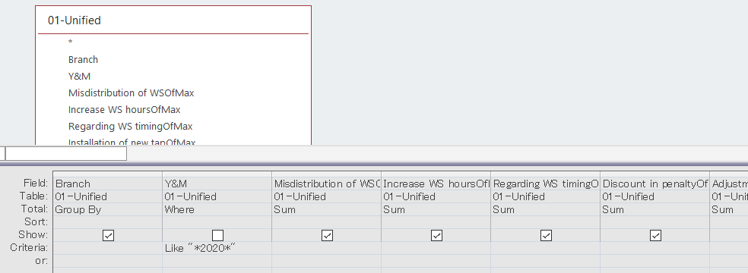
SOP for KTM-WIP Output-4 Activity ( 02- Data Process of Grievance Records )
III – Using “Unified” Query
<Create Query Dsgn.> - <Add Queries> of “Unified” query.
Use “Unified” query instead of input table so that you can prevent mistakes caused by wrong input.
For limiting periods, simply *2020* will work but,
>=2020/01/01 And <=2020/12/31 can work for any period with designated date.

