Slide 1
The Project on Capacity Development of KUKL to Improve Overall Water Supply Service In Kathmandu Valley
Standard Operation Procedure
For
KTM-WIP Output-4 Activity
( 03- Report Preparation)
Drafted 2022/12/16 by Koji KIMURA (JET)
Revised 2022/xx/xx by
Revised 2023/xx/xx by
Revised 2023/xx/xx by

Slide 2
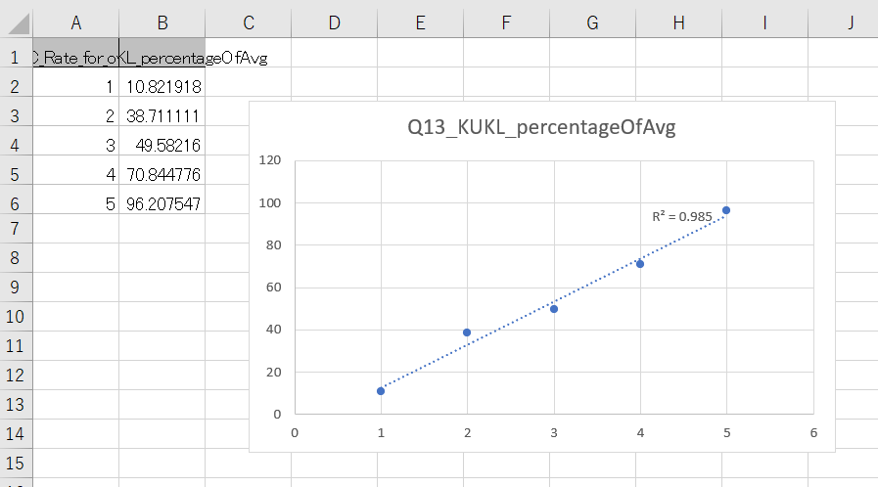
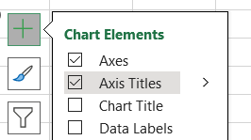
SOP for KTM-WIP Output-4 Activity ( 03- Report Preparation )
I – Excel Objects
Prepare a chart you want to use in a report.
< Delete > unnecessary objects by clicking, selecting & deleting.
< Add “+” > “Axis Titles” and input anything you should explain.

Slide 3
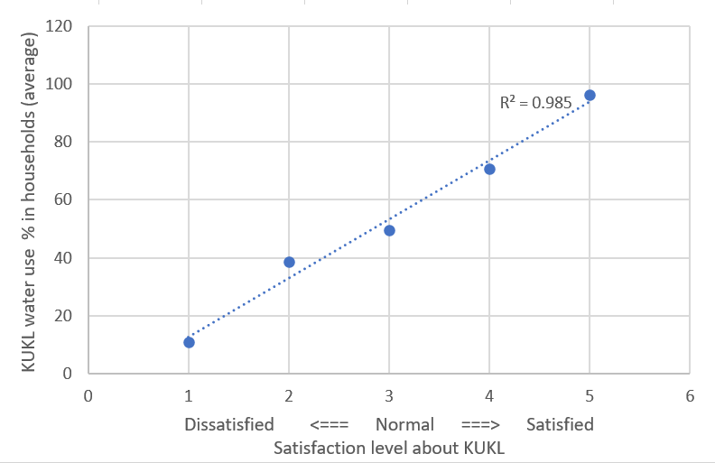
SOP for KTM-WIP Output-4 Activity ( 03- Report Preparation )
I – Excel Objects
<< NOTE >>
Charts should always be understandable to others when they first look at them.

Slide 4
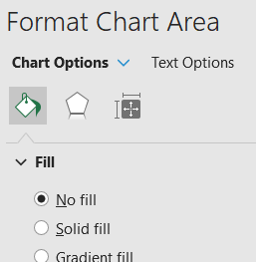
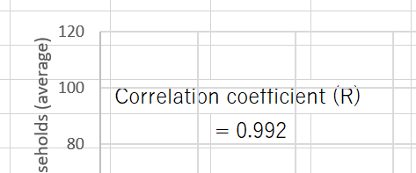
SOP for KTM-WIP Output-4 Activity ( 03- Report Preparation )
I – Excel Objects
To add information such as calculation, make the chart transparent.
(@ a space in the chart) < Right click >
(@ “Format Chart Area”) < Fill > - select “No fill”
< Input > anything you should add, put texts in order so that they look nicer.
< View > - uncheck “Gridlines”.

Slide 5
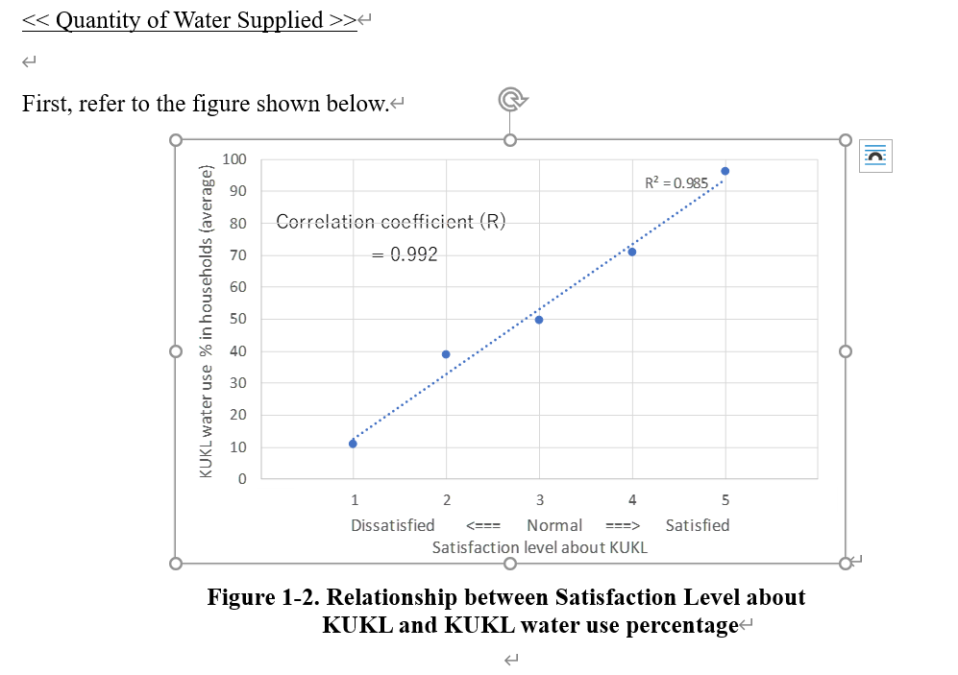
SOP for KTM-WIP Output-4 Activity ( 03- Report Preparation )
I – Excel Objects
< Short-cut > (Window) + (Shift) + (S) and select an area you want to paste in the report.
<< NOTE >> using “Snipping Tool” works the same.
(@ the right place in the report)
< Paste > -
< Press > the corner of the object and adjust the size.

Slide 6
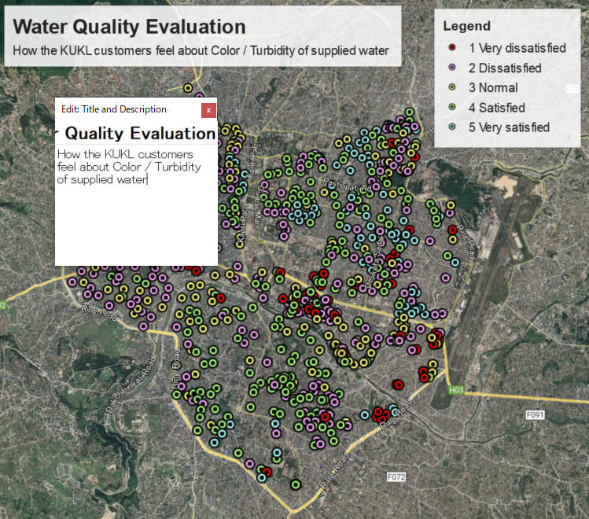
SOP for KTM-WIP Output-4 Activity ( 03- Report Preparation )
II – Google Earth Objects
< File > - < Print > and edit description as you like.
Adjust the screen for suitable size and alignment.
< File > - < Print > and edit description as you like.
Adjust the screen for suitable size and alignment.
< Short-cut > (Window) + (Shift) + (S) and select an area you want to paste in the report.

